Slide 1
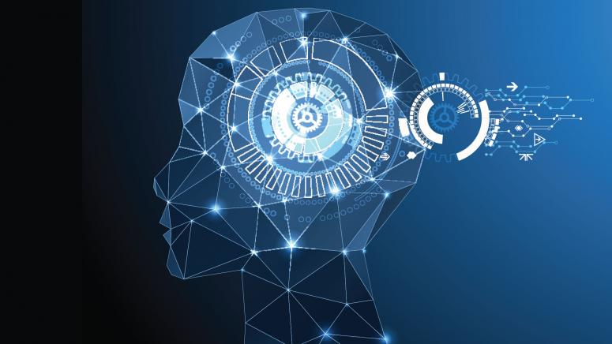
Reinforcement Learning
Yutong Gao
Varaprasad Kurra

Slide 2
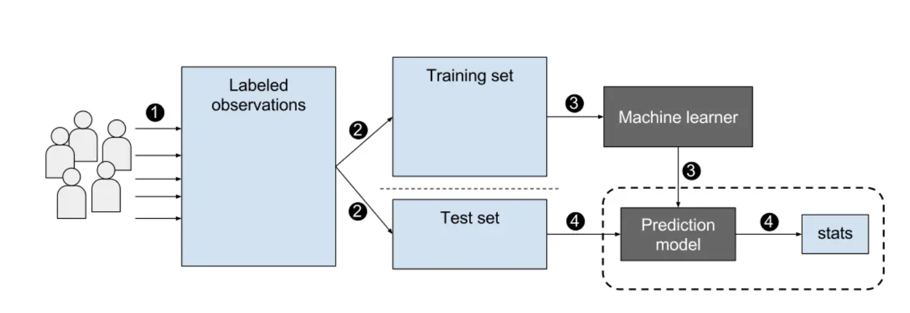
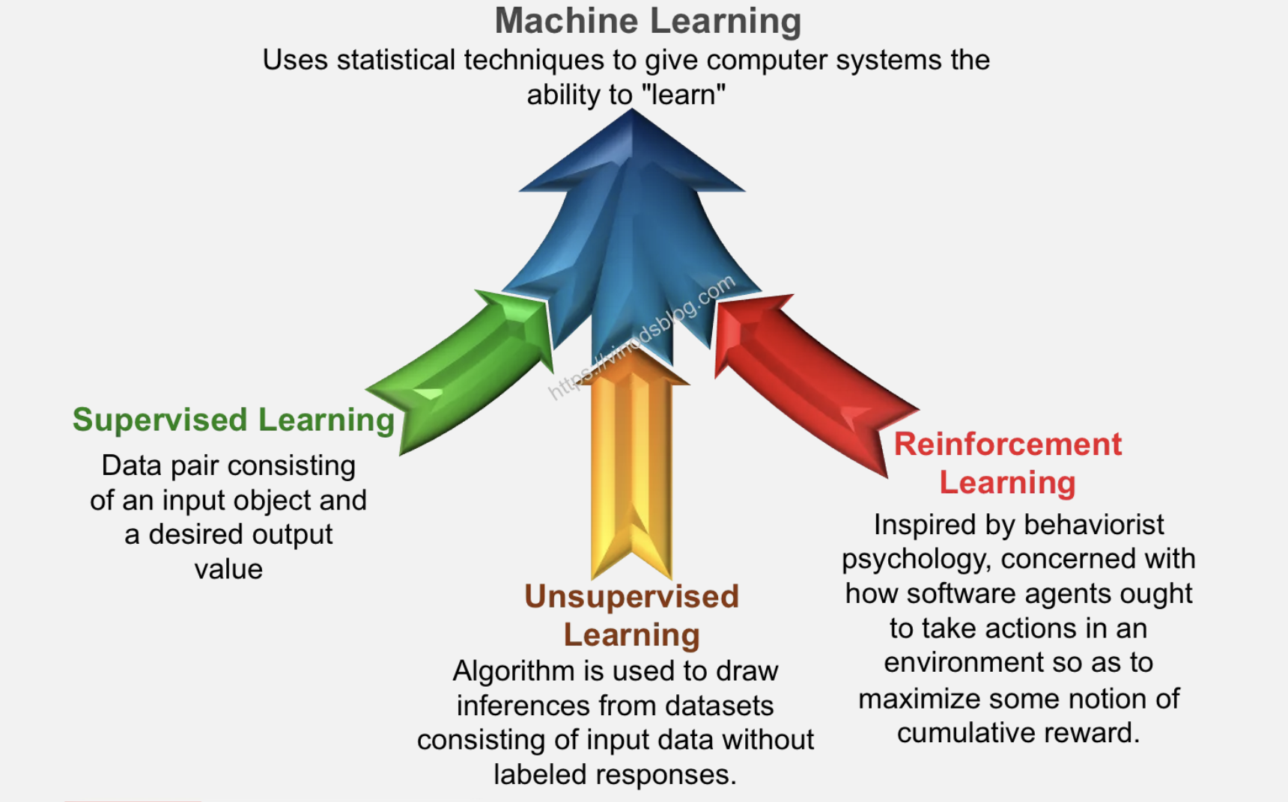
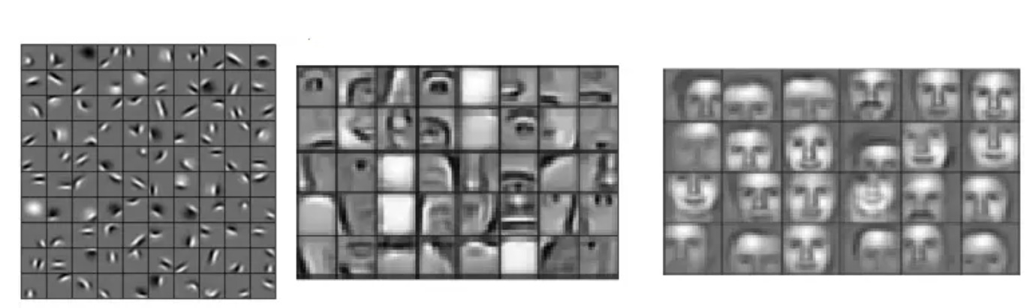
Learning Types

Slide 3
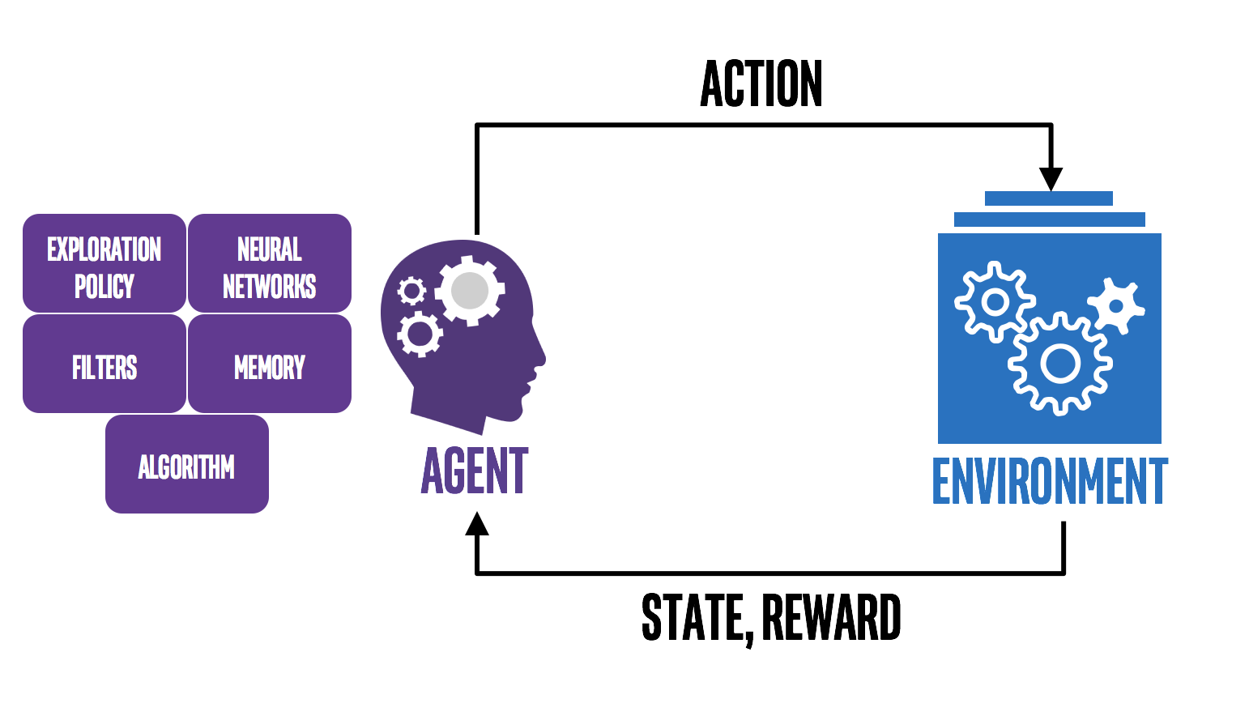
What is Reinforcement Learning?
Agent. The program you train, with the aim of doing a job you specify.
Environment. The world, real or virtual, in which the agent performs actions.
Action. A move made by the agent, which causes a status change in the environment.
Rewards. The evaluation of an action, which can be positive or negative.

Slide 4
What is Reinforcement Learning?
Reinforcement learning is an area of Machine Learning. It is about taking suitable action to maximize reward in a particular situation.
It is employed by various software and machines to find the best possible behavior or path it should take in a specific situation
How Reinforcement Learning differs:
Difference #1: Static Vs Dynamic
Difference #2: No Explicit Right Answer
Difference #3: RL Requires Exploration -> Explore and Exploit
Difference #4: RL is a Multiple-Decision Process

Slide 5
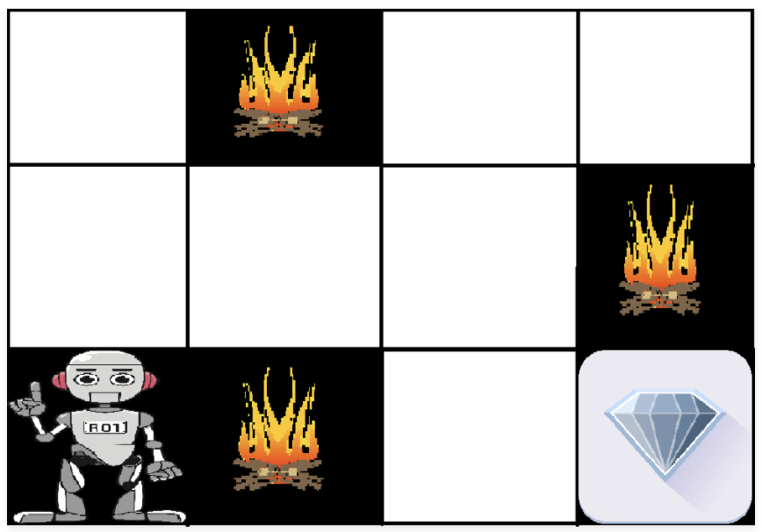
An Example of Reinforcement Learning
The image shows the robot, diamond, and fire.
The goal of the robot is to get the reward that is the diamond and avoid the hurdles that are fire.
The robot learns by trying all the possible paths and then choosing the path which gives him the reward with the least hurdles.
Each right step will give the robot a reward and each wrong step will subtract the reward of the robot.
The total reward will be calculated when it reaches the final reward that is the diamond.

Slide 6
Difference between Reinforcement learning and Supervised learning:
Parameter | Reinforcement Learning | Supervised Learning
Decision style | Reinforcement learning helps you to take your decisions sequentially. | In this method, a decision is made on the input given at the beginning.
Works on | Works on interacting with the environment. | Works on examples or given sample data.
Dependency on decision | In RL method learning decision is dependent. Therefore, you should give labels to all the dependent decisions. | Supervised learning the decisions which are independent of each other, so labels are given for every decision.
Best suited | Supports and work better in AI, where human interaction is prevalent. | It is mostly operated with an interactive software system or applications.

Slide 7
Types of Reinforcement Learnings: They are of two types
Positive Learning 2. Negative Learning
Positive:
It is defined as an event, that occurs because of specific behavior. It increases the strength and the frequency of the behavior and impacts positively on the action taken by the agent.
This type of Reinforcement helps you to maximize performance and sustain change for a more extended period. However, too much Reinforcement may lead to over-optimization of state, which can affect the results.
Negative:
Negative Reinforcement is defined as strengthening of behavior that occurs because of a negative condition which should have stopped or avoided. It helps you to define the minimum standard of performance. However, the drawback of this method is that it provides enough to meet up the minimum behavior.

Slide 8

Pros and Cons of RL:
Pros:
Reinforcement learning models can outperform humans in many tasks. DeepMind’s AlphaGo program, a reinforcement learning model, defeated the world champion Lee Sedol at the game of Go in March 2016.
This technique is preferred to achieve long-term results, which are very difficult to achieve.
Reinforcement learning can be used to solve very complex problems that cannot be solved by conventional techniques.
Reinforcement learning is intended to achieve the ideal behavior of a model within a specific context, to maximize its performance.
It can be useful when the only way to collect information about the environment is to interact with it.

Slide 9

Cons:
Reinforcement learning as a framework is wrong in many different ways, but it is precisely the quality that makes it useful.
Too much reinforcement learning can lead to an overload of states, which can diminish the results.
This learning is not preferable to use for solving simple problems.
This learning model assumes the world is Markovian, which it is not. The Markovian model describes a sequence of possible events in which the probability of each event depends only on the state attained in the previous event.
The curse of dimensionality limits reinforcement learning heavily for real physical systems.

Slide 10
Reinforcement Learning in Dynamic Brain
Model-free vs Model-based RL
What is Model-free RL?
This algorithm does not learn a model of the structure of the world, but instead learns about the value of actions on the basis of past reinforcement.
What is Model-based RL?
By contrast MB RL, the agent encodes an internal model of the world, that is, the relationship between states, actions and subsequent states, and the outcomes experienced in those states, and then computes values on-line by searching prospectively through that internal model.

Slide 11
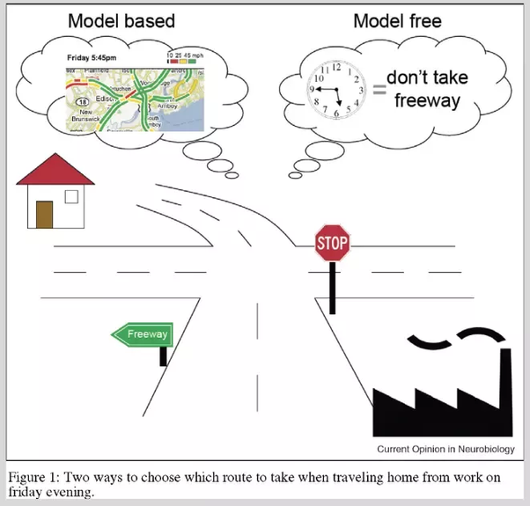
MF RL vs MB RL
The Model-based RL is a deductive approach for solving a problem. Agent uses its general understanding of the system to derive a best action. Model-free RL is an inductive approach for solving a problem. Agent uses its past experience as empirical evidence and use frequency statistics to estimate the value of its action.

Slide 12
Applications of Reinforcement Learning in Real World
While Convolution Neural Network (CNN) and Recurrent Neural Network (RNN) are becoming more important for businesses due to their applications in Computer Vision (CV) and Natural Language Processing (NLP).
Reinforcement Learning (RL) as a framework for computational neuroscience to model decision making process seems to be undervalued. (Dopamine is a type of neurotransmitter.)
Resources management in computer clusters
Designing algorithms to allocate limited resources to different tasks is challenging and requires human-generated heuristics. The paper “Resource Management with Deep Reinforcement Learning” showed how to use RL to automatically learn to allocate and schedule computer resources to waiting jobs, with the objective to minimize the average job slowdown.

Slide 13
Traffic Light Control
In the paper “Reinforcement learning-based multi-agent system for network traffic signal control”, researchers tried to design a traffic light controller to solve the congestion problem. Tested only on simulated environment though, their methods showed superior results than traditional methods and shed a light on the potential uses of multi-agent RL in designing traffic system.
Robotics
There are tremendous work on applying RL in Robotics. Readers are referred to for a survey of RL in Robotics. In particular trained a robot to learn policies to map raw video images to robot’s actions. The RGB images were fed to a CNN and outputs were the motor torques. The RL component was the guided policy search to generate training data that came from its own state distribution.

Slide 14
A distributional code for value in dopamine-based reinforcement learning (Dabney et al. 2020)
Distributional reinforcement learning
A spectrum of pessimistic and optimistic prediction
A distributional code in dopamine
Conclusion - Evidence it might be implemented in the brain
Dabney, W., Kurth-Nelson, Z., Uchida, N. et al. A distributional code for value in dopamine-based reinforcement learning. Nature 577, 671–675 (2020). https://doi.org/10.1038/s41586-019-1924-6
Notes:
Dopamine neurons are clustered in the midbrain, there are relationship between reward and firing of these neurons, and changed as the animals became more experienced in a given task.

Slide 15
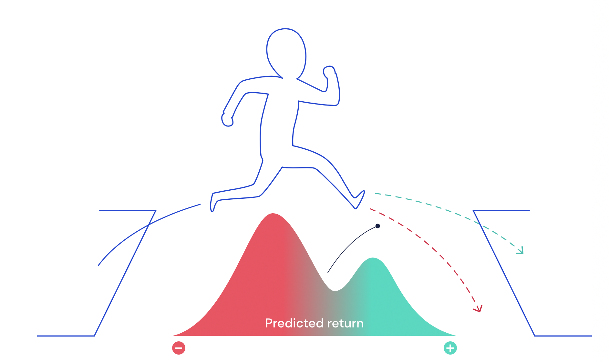
Distributional reinforcement learning
Temporal Difference learning algorithm is an algorithm of reinforcement learning.
Problem Statement: trained to traverse an obstacle course, jumps across a gap, the agent is unclear about whether it will fall, or reach the other side.
Classic TD learning: learn to predict the future reward received on average.
Distributional TD learning: learns to predict the full spectrum of future reward. [possibility of falling, possibility of successfully reaching]

Slide 16

A spectrum of pessimistic and optimistic prediction
The standard TD learns a single prediction-the average expected reward
The distributional TD learns a set of distinct prediction, and each predictor applies a different transformation to its reward prediction errors(RPE)
Some predictors "amplify" or "overweight" their reward prediction errors (RPE) selectively when the reward prediction error is positive. This causes the predictor to learn a more optimistic reward prediction, corresponding to a higher part of the reward distribution.
Other predictors amplify their negative reward prediction errors and so learn more pessimistic predictions. All together, a set of predictors with a diverse set of pessimistic and optimistic weightings map out the full reward distribution
Notes:
amplify their negative reward prediction errors and so learn more pessimistic predictions.

Slide 17
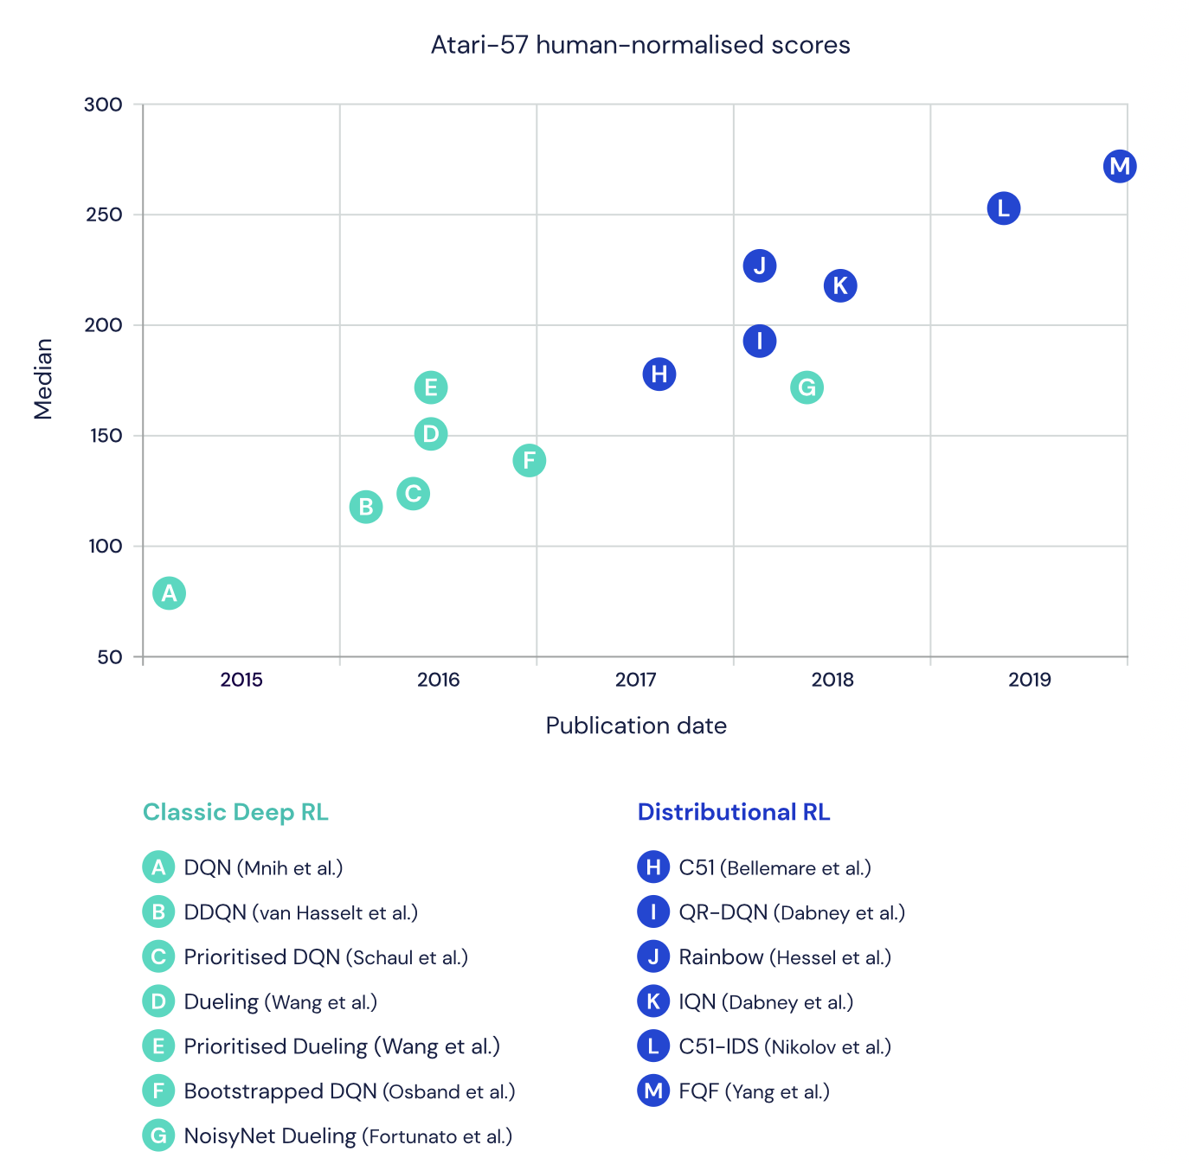
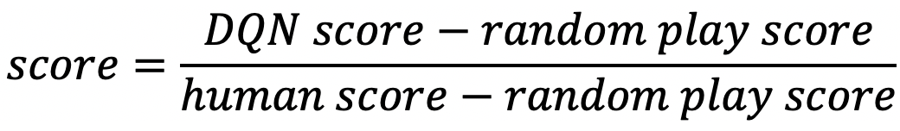
Powerful of Distributional RL
Human-normalised score:
A key ingredient is that learning about the distribution of rewards gives the neural network a more powerful signal for shaping its representation in a way that’s robust to changes in the environment or changes in the policy.
Notes:
agent

Slide 18
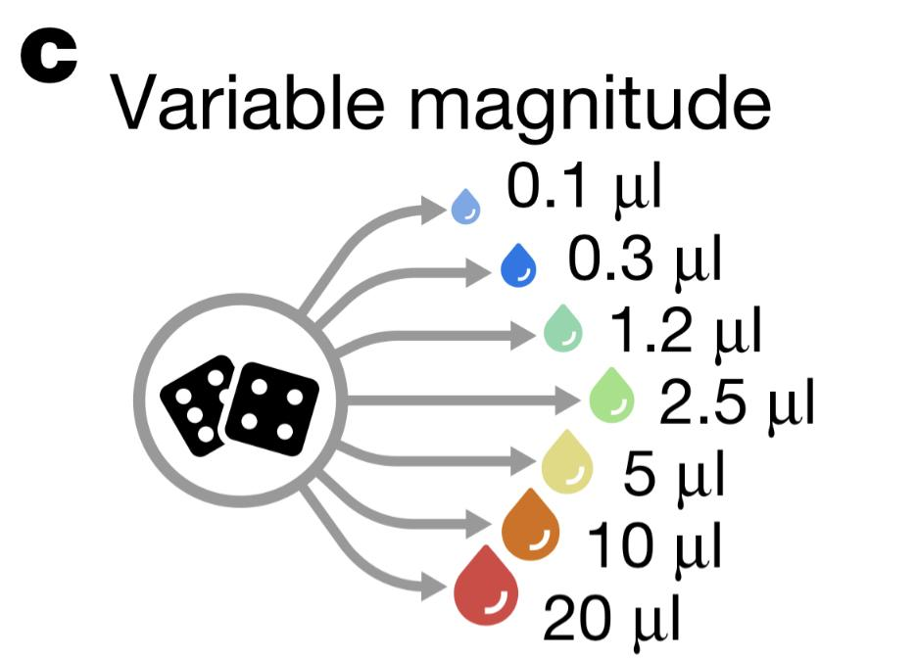
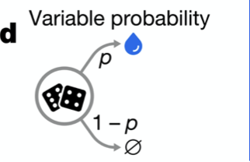
A distributional code in dopamine
Is distributional TD used in the brain?
Purpose: whether the activity of dopamine neurons was more consistent with standard TD or distributional TD
Neuronal data and analysis: single-unit recordings on the ventral tegmental area (VTA)neurons
electrophysiological responses of cells to a brief blue light pulse train, which stimulates only dopamine transporter(DAT)-expressing cell
Variable-probability task: 31 cells were recorded from five animal.
Variable-magnitude task: 40 cells were recorded from five animals

Slide 19
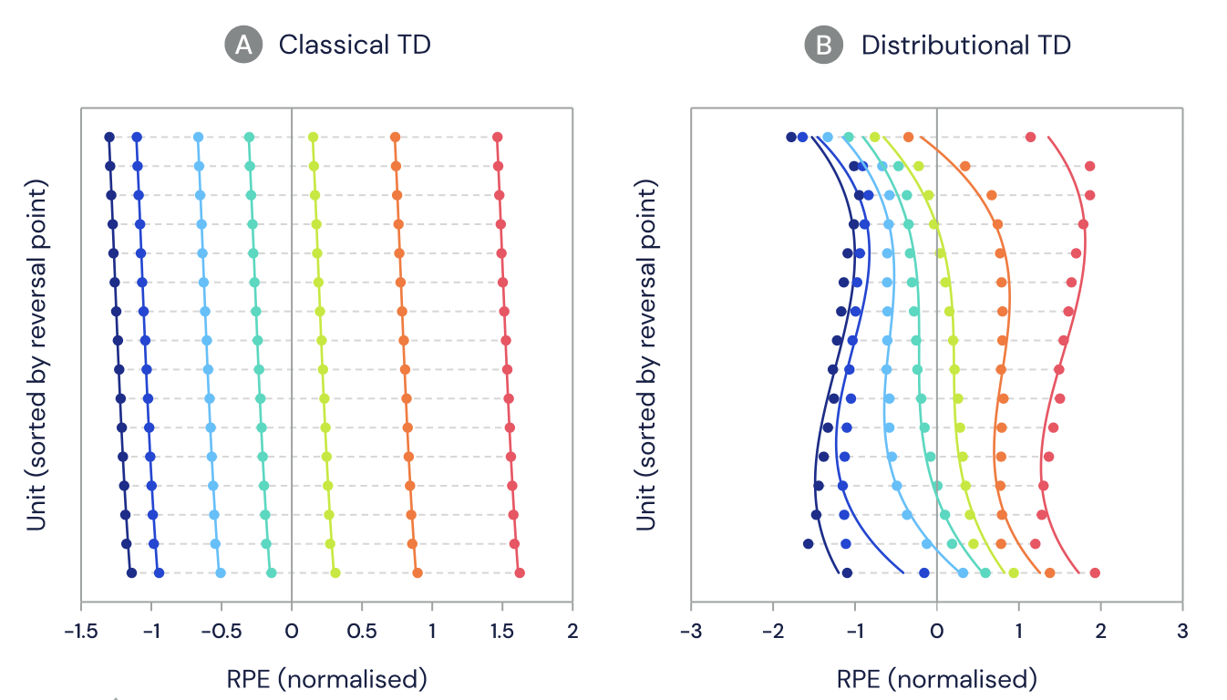

A distributional code in dopamine
Is distributional TD used in the brain?
Dopamine cells change their firing rate to indicate a prediction error. For each dopamine cell, the reversal size was determined for which it didn’t change its baseline firing rate, the size call reverse points
?Whether these reversal points were different between cells
?whether the activity of dopamine neurons was more consistent with standard TD or distributional TD
Simulated dopamine cells
Notes:
classic TD predicts no diversity in optimism
MICE ARE GIVEN WATER REWARDS OF A RANDOMLY DETERMINED, VARIABLE AMOUNT, RANGING IN MAGNITUDE FROM 0.1 UL TO 20 UL

Slide 20
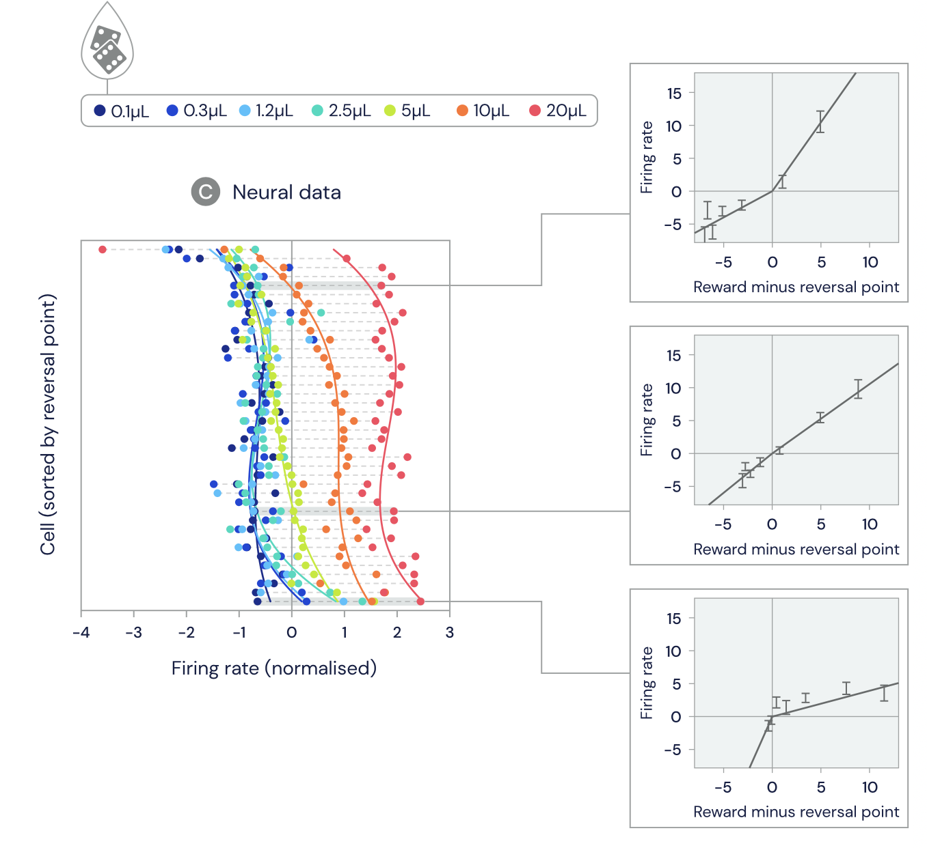
Real Dopamine cell
There were marked differences between cells, some cell predicting very large amounts of reward, and other cells predicting very little reward.
-> difference reverse point
Optimistic cells, amplified their positive reward prediction error, also have higher reverse points

Slide 21
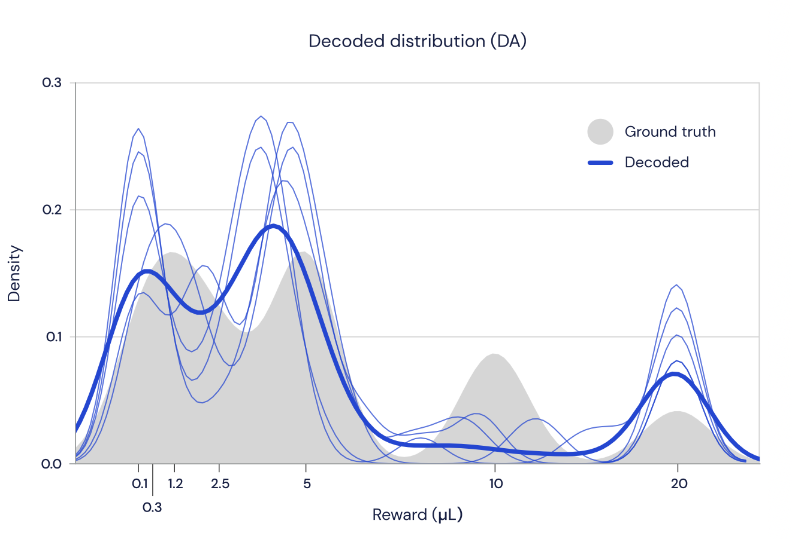
A distributional code in dopamine
Decode the reward distribution from the firing rates of dopamine cells
This reconstruction relied on interpreting the firing rates of dopamine cells as the reward prediction errors of a distributional TD model, and performing inference to determine what distribution that model had learned about.
Notes:
Blue trace: reconstruct a reward distribution using only firing rates

Slide 22
Conclusion
Dopamine neurons in the brain were each tuned to different levels of pessimism or optimism
In artificial reinforcement learning systems, this diverse tuning creates a richer training signal that greatly speeds learning in neural networks, and speculate that the brain might use it for the same reason.
Discovery validates distributional reinforcement learning – it gives us increased confidence that AI research is on the right track, since this algorithm is already being used in the most intelligent entity we're aware of: the brain.

Slide 23
Future work/question
What happens if an individual's brain “listens” selectively to optimistic versus pessimistic dopamine neurons? Does this give rise to impulsivity, or depression?

